Slide 1
Reasoning on knowledge graphs

Slide 2
Overview
Queries on knowledge graphs
Predictive queries
Predictive path queries with TransE
Predictive conjunctive queries with Query2Box

Slide 3
Queries on knowledge graphs

Slide 4
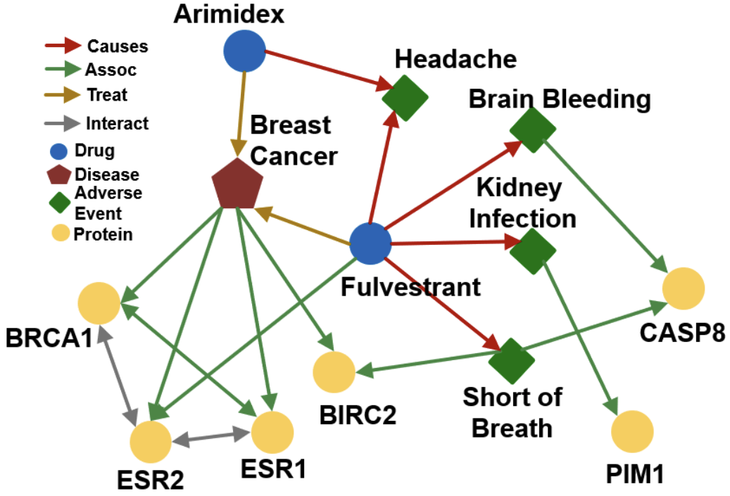
Queries (reasoning) on knowledge graphs
How do we perform multi-hop (edge) reasoning over knowledge graphs (KGs)?
Image credit: Jure Leskovec, http://cs224w.stanford.edu

Slide 5
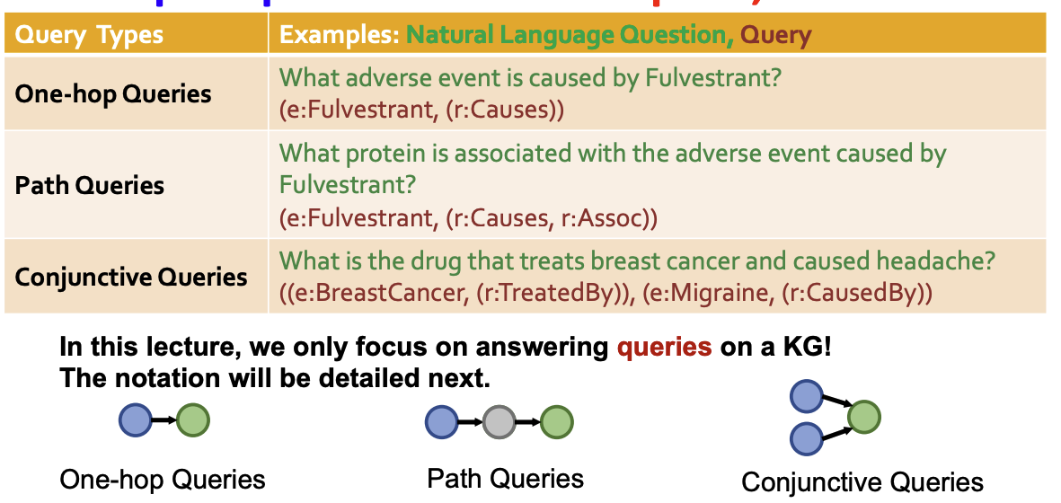
Types of multi-hop queries
Can we answer complex queries on a KG?
Image credit: Jure Leskovec, http://cs224w.stanford.edu

Slide 6
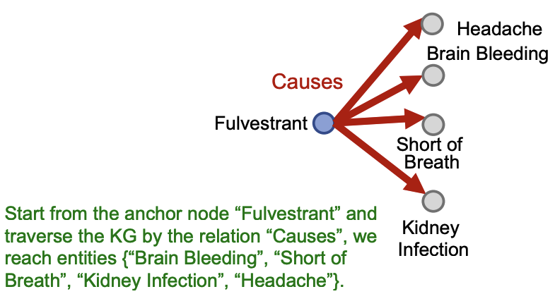
One-hop queries
One-hope query: Is t an answer to the query (h, r)?
Example: What side effects are caused by the drug Fulvestrant?
Query: (e: Fulvestrant, (r:Causes))
Image credit: Jure Leskovec, http://cs224w.stanford.edu

Slide 7
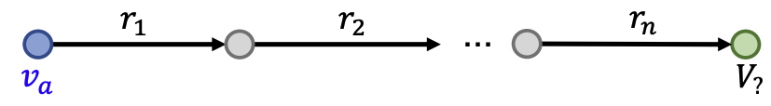
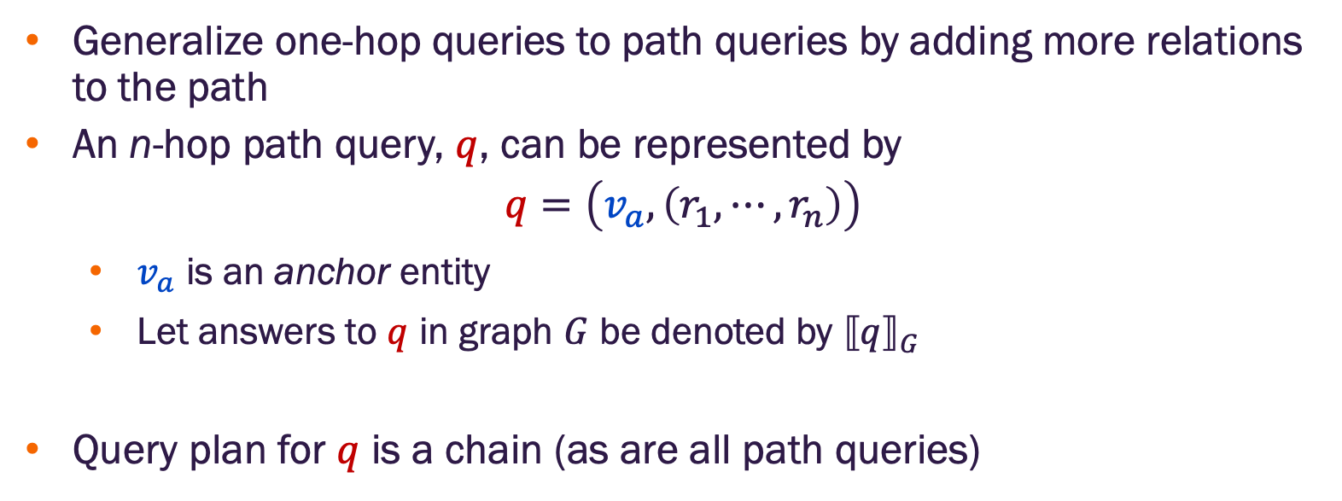
Path queries
Generalize one-hop queries to path queries by adding more relations to the path
An n-hop path query, $q$, can be represented by
$q=\left(v_{a}, \left(r_{1}, ⋯,r_{n}\right)\right)$
$v_{a}$ is an anchor entity
Let answers to $q$ in graph $G$ be denoted by ${⟦q⟧}_{G}$
Query plan for $q$ is a chain (as are all path queries)
Image credit: Jure Leskovec, http://cs224w.stanford.edu

Slide 8
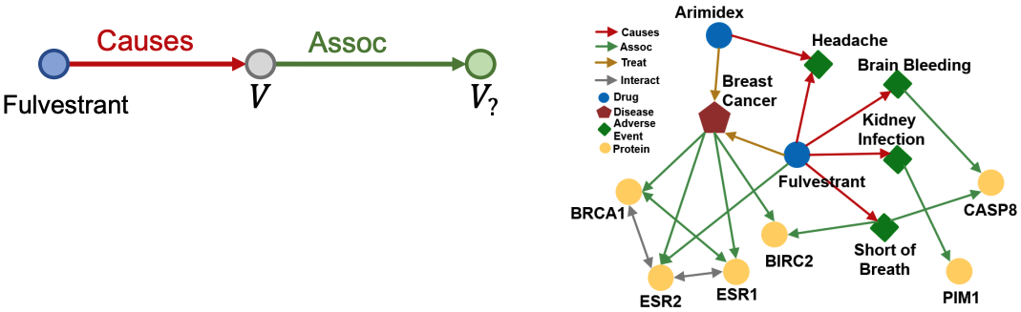
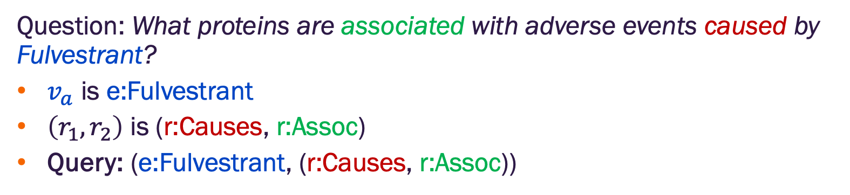
Path queries
Question: What proteins are associated with adverse events caused by Fulvestrant?
$v_{a}$ is e:Fulvestrant
$\left(r_{1},r_{2}\right)$ is (r:Causes, r:Assoc)
Query: (e:Fulvestrant, (r:Causes, r:Assoc))
Image credit: Jure Leskovec, http://cs224w.stanford.edu

Slide 9
Path queries
Question: What proteins are associated with adverse events caused by Fulvestrant?
Query: (e:Fulvestrant, (r:Causes, r:Assoc))
Given a KG, how do we answer a path query?
Image credit: Jure Leskovec, http://cs224w.stanford.edu

Slide 10
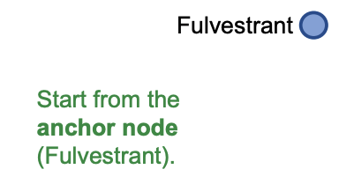
Traversing knowledge graphs for path queries
Question: What proteins are associated with adverse events caused by Fulvestrant?
Query: (e:Fulvestrant, (r:Causes, r:Assoc))
Image credit: Jure Leskovec, http://cs224w.stanford.edu

Slide 11
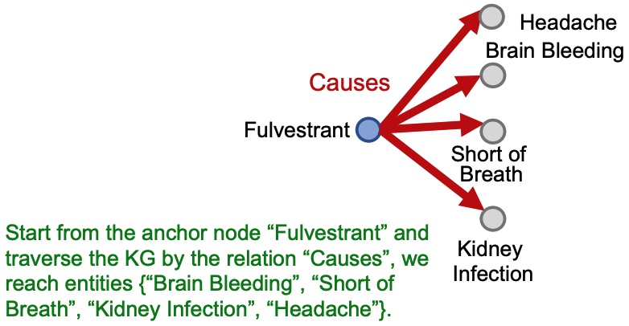
Traversing knowledge graphs for path queries
Question: What proteins are associated with adverse events caused by Fulvestrant?
Query: (e:Fulvestrant, (r:Causes, r:Assoc))
Image credit: Jure Leskovec, http://cs224w.stanford.edu

Slide 12
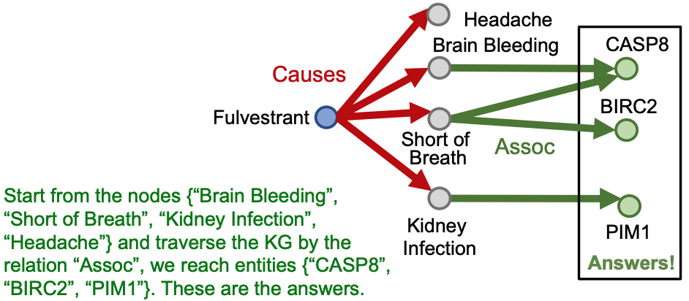
Traversing knowledge graphs for path queries
Question: What proteins are associated with adverse events caused by Fulvestrant?
Query: (e:Fulvestrant, (r:Causes, r:Assoc))
Image credit: Jure Leskovec, http://cs224w.stanford.edu

Slide 13
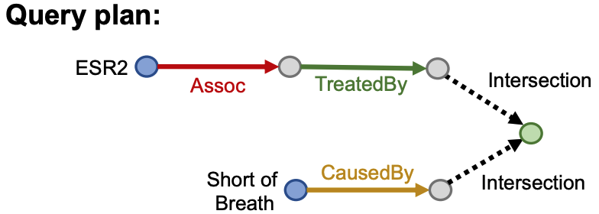
Conjunctive queries
Question: What are drugs that cause shortness of breath and treat diseases associated with protein ESR2?
Query: [(e:ESR2, (r:Assoc, r:TreatedBy)), (e:Short of Breath, (r:CausedBy))]
Image credit: Jure Leskovec, http://cs224w.stanford.edu

Slide 14
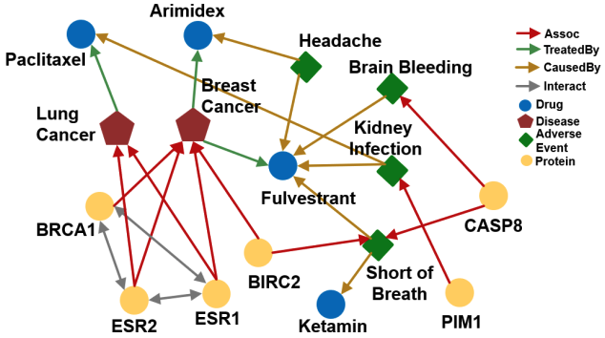
Conjunctive queries
Question: What are drugs that cause shortness of breath and treat diseases associated with protein ESR2?
Query: [(e:ESR2, (r:Assoc, r:TreatedBy)), (e:Short of Breath, (r:CausedBy))]
How do we answer this question by KG traversal?
Image credit: Jure Leskovec, http://cs224w.stanford.edu

Slide 15
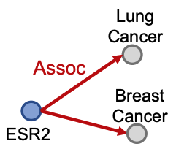
Traversing knowledge graphs for conjunctive queries
Question: What are drugs that cause shortness of breath and treat diseases associated with protein ESR2?
Query: [(e:ESR2, (r:Assoc, r:TreatedBy)), (e:Short of Breath, (r:CausedBy))]
Traverse KG from anchor nodes: ESR2 and Short of Breath
Traverse from the first anchor ESR2 by relation Assoc to reach entities {Lung Cancer, Breast Cancer}
Image credit: Jure Leskovec, http://cs224w.stanford.edu

Slide 16
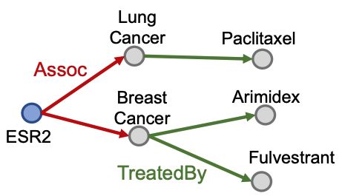
Traversing knowledge graphs for conjunctive queries
Question: What are drugs that cause shortness of breath and treat diseases associated with protein ESR2?
Query: [(e:ESR2, (r:Assoc, r:TreatedBy)), (e:Short of Breath, (r:CausedBy))]
Traverse KG from anchor nodes: ESR2 and Short of Breath
Traverse from the entities {Lung Cancer, Breast Cancer} by the relation TreatedBy to reach the drug entities {Paclitaxel, Arimidex, Fulvestrant}
Image credit: Jure Leskovec, http://cs224w.stanford.edu

Slide 17
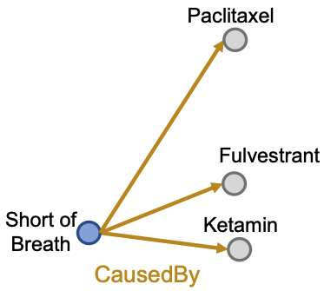
Traversing knowledge graphs for conjunctive queries
Question: What are drugs that cause shortness of breath and treat diseases associated with protein ESR2?
Query: [(e:ESR2, (r:Assoc, r:TreatedBy)), (e:Short of Breath, (r:CausedBy))]
Traverse KG from anchor nodes: ESR2 and Short of Breath
Traverse from the second anchor Short of Breath by the relation CausedBy to reach the set of entities {Paclitaxel, Fulvestrant, Ketamin}
Image credit: Jure Leskovec, http://cs224w.stanford.edu

Slide 18
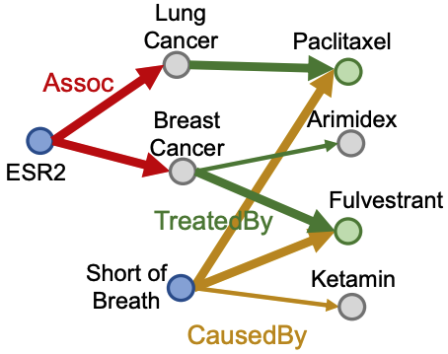
Traversing knowledge graphs for conjunctive queries
Question: What are drugs that cause shortness of breath and treat diseases associated with protein ESR2?
Query: [(e:ESR2, (r:Assoc, r:TreatedBy)), (e:Short of Breath, (r:CausedBy))]
Traverse KG from anchor nodes: ESR2 and Short of Breath
Take the intersection between the two drug sets to get the answer set {Paclitaxel, Fulvestrant}
Image credit: Jure Leskovec, http://cs224w.stanford.edu

Slide 19
Predictive queries

Slide 20
Answering queries on incomplete KGs
Answering queries on KGs seems easy: just traverse the graph
But KGs are incomplete
Many relations between entities are missing – for example, we lack knowledge of many associations among biomedical entities
Enumerating all facts requires non-trivial time and cost, so we shouldn’t expect any KG to ever be complete
Due to KG incompleteness, traversal alone will not identify all relations
Is this the best we can do?

Slide 21
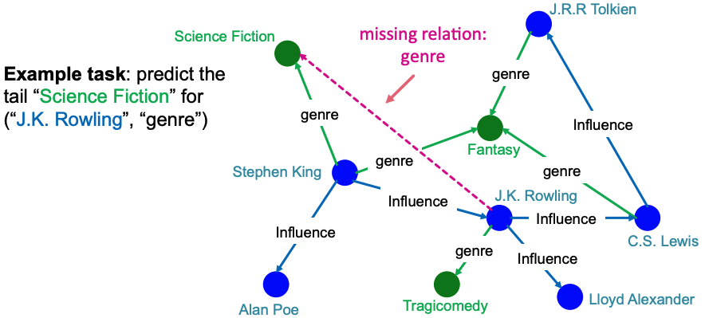
Knowledge graph (KG) completion task
Given a large KG, can we ”complete” it (i.e., add missing edges)
Task is typically formulated as predicting tails (or consequents)
Consider relations in a directed KG represented as a tuple (head, relation, tail) where head (h) has relation (r) with tail (t)
Given (head, relation) predict missing tails
Image credit: Jure Leskovec, http://cs224w.stanford.edu

Slide 22
Predictive one-hop queries
We can formulate KG completion problems as answering one-hop queries
KG completion: Is the edge (h, r, t) in the KG?
One-hope query: Is t an answer to the query (h, r)?
Example: What side effects are caused by the drug Fulvestrant?

Slide 23
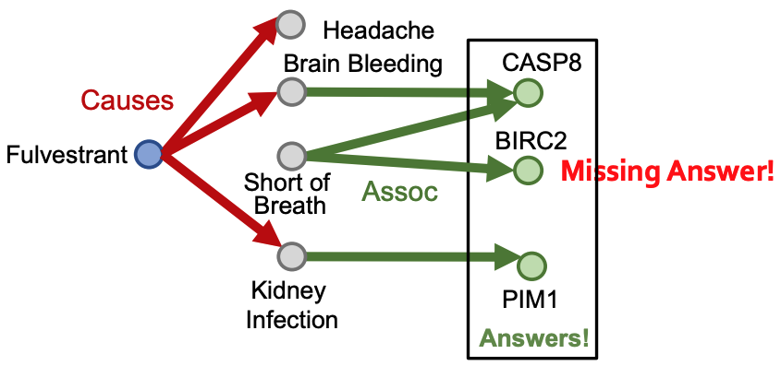
Predictive path queries?
Question: What proteins are associated with adverse events caused by Fulvestrant?
Query: (e:Fulvestrant, (r:Causes, r:Assoc))
Image credit: Jure Leskovec, http://cs224w.stanford.edu

Slide 24
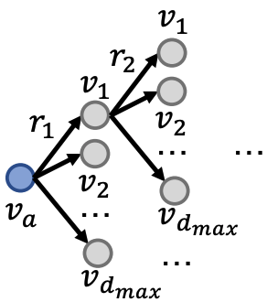
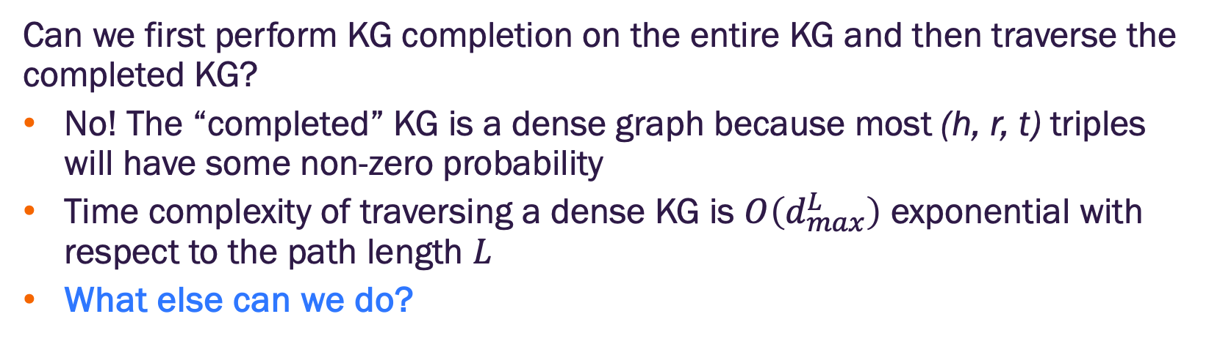
Predictive path queries
Can we first perform KG completion on the entire KG and then traverse the completed KG?
No! The “completed” KG is a dense graph because most (h, r, t) triples will have some non-zero probability
Time complexity of traversing a dense KG is $O\left(d_{max}^{L}\right)$ exponential with respect to the path length $L$
What else can we do?
Image credit: Jure Leskovec, http://cs224w.stanford.edu

Slide 25
Predictive queries
We need methods to answer path-based queries on an incomplete KG
Want to implicitly impute and account for missing relations (incompleteness)
Want to be able to answer arbitrary queries
Generalization of the link prediction task
Image credit: Jure Leskovec, http://cs224w.stanford.edu

Slide 26
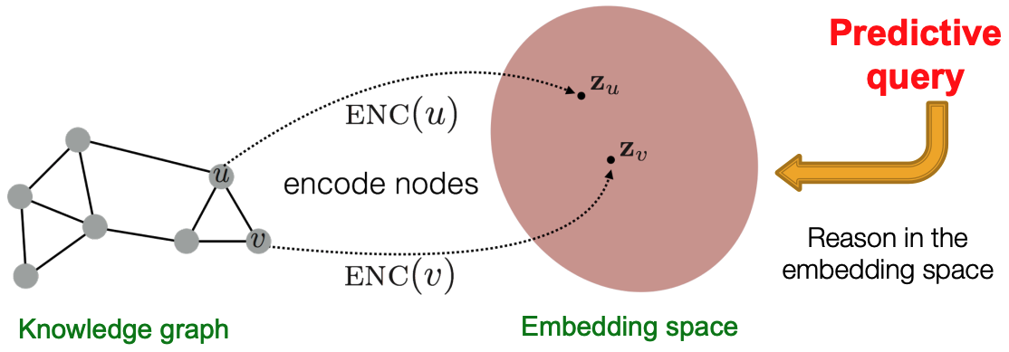
Embedding queries concept
Idea: Map queries into an embedding space and learn to reason in that space
Embed query into a single point in the Euclidean space under the assumption that answer nodes are close to the query
Query2Box: Embed query into a hyper-rectangle (box) in the Euclidean space under the assumption that answer nodes are in the box volume
Image credit: Jure Leskovec, http://cs224w.stanford.edu

Slide 27
Predictive path queries with TransE

Slide 28
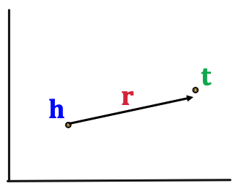
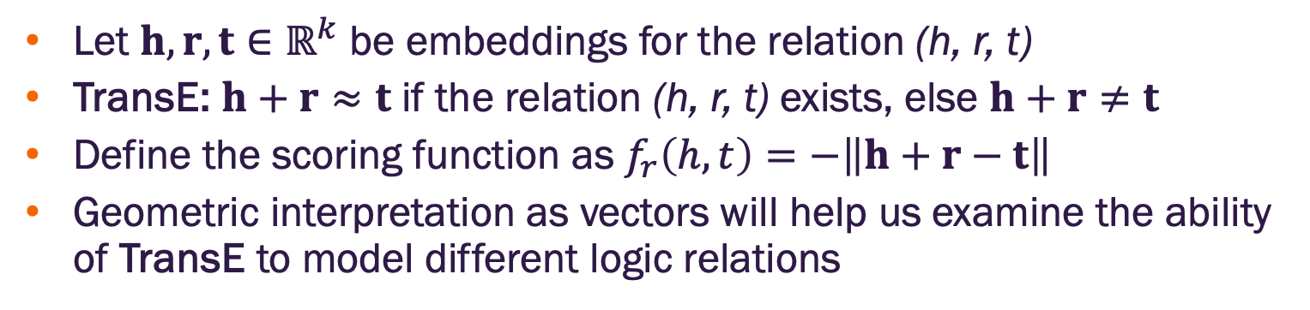
Trans(lation) Embedding (TransE)
Let $h, r, t∈ℝ^{k}$ be embeddings for the relation (h, r, t)
TransE: $h+r≈t$ if the relation (h, r, t) exists, else $h+r≠t$
Define the scoring function as $f_{r}\left(h,t\right)=−\left\|h+r−t\right\|$
Geometric interpretation as vectors will help us examine the ability of TransE to model different logic relations
Image credit: Jure Leskovec, http://cs224w.stanford.edu

Slide 29
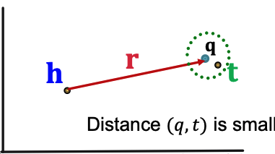
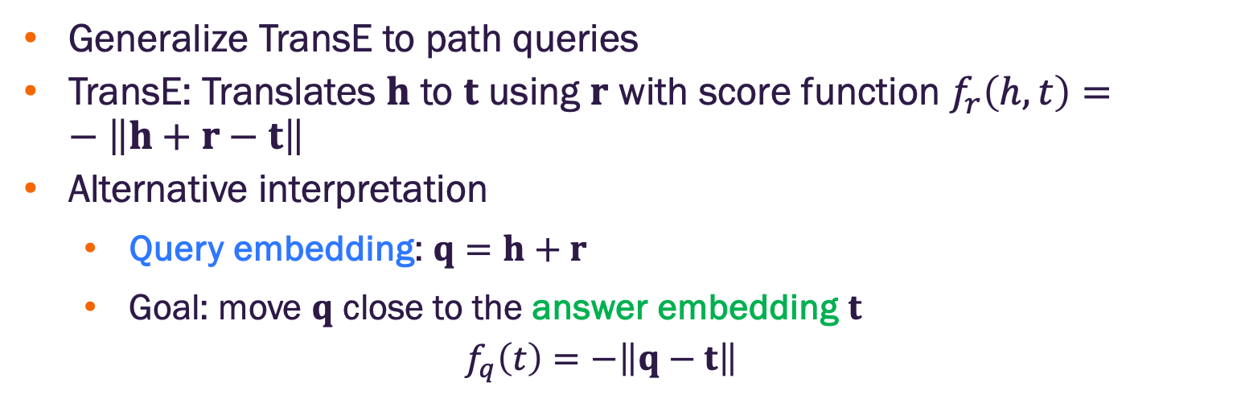
Predictive path queries with TransE
Generalize TransE to path queries
TransE: Translates $h$ to $t$ using $r$ with score function $f_{r}\left(h,t\right)=−\left\|h+r−t\right\|$
Alternative interpretation
Query embedding: $q=h+r$
Goal: move $q$ close to the answer embedding $t$
$$f_{q}\left(t\right)=−\left\|q−t\right\|$$
Image credit: Jure Leskovec, http://cs224w.stanford.edu

Slide 30
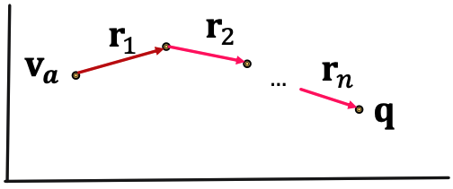
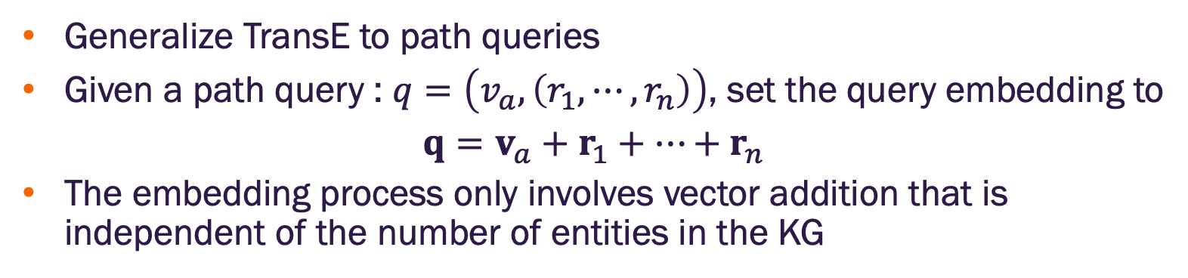
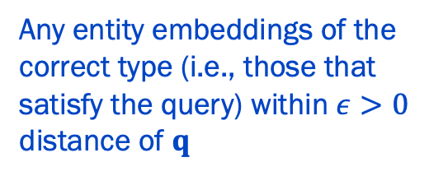
Predictive path queries with TransE
Generalize TransE to path queries
Given a path query : $q=\left(v_{a}, \left(r_{1}, ⋯,r_{n}\right)\right)$, set the query embedding to
$$q=v_{a}+r_{1}+⋯+r_{n}$$
The embedding process only involves vector addition that is independent of the number of entities in the KG
Any entity embeddings of the correct type (i.e., those that satisfy the query) within $ε>0$ distance of $q$
Image credit: Jure Leskovec, http://cs224w.stanford.edu

Slide 31
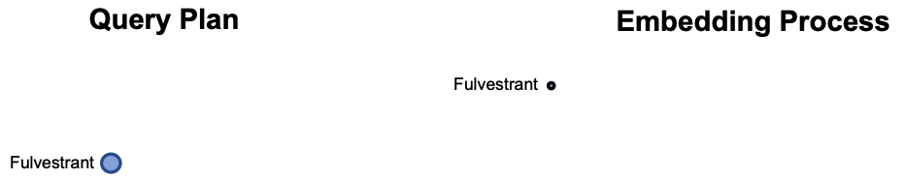
An example of predictive path queries with TransE
Question: What proteins are associated with adverse events caused by Fulvestrant?
Query: (e:Fulvestrant, (r:Causes, r:Assoc))
Follow the query plan:
Image credit: Jure Leskovec, http://cs224w.stanford.edu

Slide 32
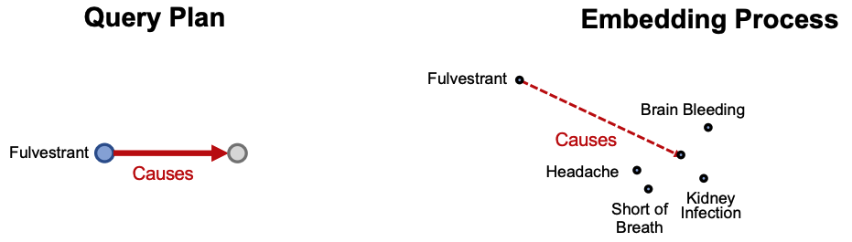
An example of predictive path queries with TransE
Question: What proteins are associated with adverse events caused by Fulvestrant?
Query: (e:Fulvestrant, (r:Causes, r:Assoc))
Follow the query plan:
Image credit: Jure Leskovec, http://cs224w.stanford.edu

Slide 33
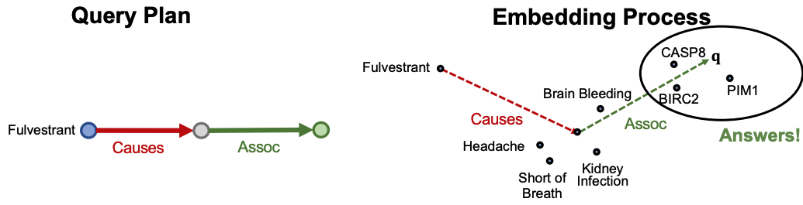
An example of predictive path queries with TransE
Question: What proteins are associated with adverse events caused by Fulvestrant?
Query: (e:Fulvestrant, (r:Causes, r:Assoc))
Follow the query plan:
Image credit: Jure Leskovec, http://cs224w.stanford.edu

Slide 34
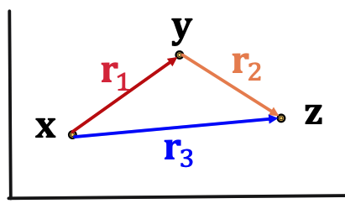
Predictive path query training on TransE
We can train a TransE model to optimize the knowledge graph completion objective (tail completion)
Recall, TransE handles compositional relations, hence it naturally handles path queries over multiple hops
We get this for “free”!
Image credit: Jure Leskovec, http://cs224w.stanford.edu

Slide 35
Predictive conjunctive queries with Query2Box

Slide 36
Predictive conjunctive queries
Question: What are drugs that cause shortness of breath and treat diseases associated with protein ESR2?
Query: [(e:ESR2, (r:Assoc, r:TreatedBy)), (e:Short of Breath, (r:CausedBy))]
Traverse KG from anchor nodes: ESR2 and Short of Breath
If this edge was missing, we would not find Fulvestrant as an answer
Image credit: Jure Leskovec, http://cs224w.stanford.edu

Slide 37
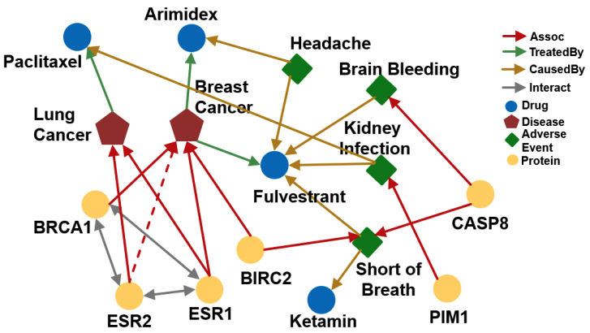
Predictive conjunctive queries
How can we use embeddings to implicitly impute the missing relation (ESR2, Assoc, Breast Cancer)?
Intuition: ESR2 interacts with BRCA1 and ESR1, both of which are associated with breast cancer.
Image credit: Jure Leskovec, http://cs224w.stanford.edu

Slide 38
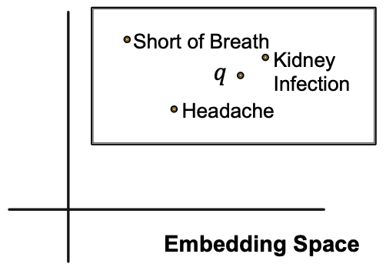

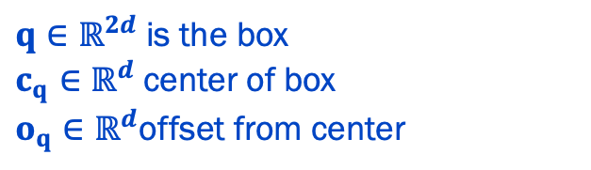
Box embeddings
Embed queries, q, in a hyper-rectangle (box)
$$q≡\left\{c_{q},o_{q}\right\}$$
$q∈ℝ^{2d}$is the box
$c_{q}∈ℝ^{d}$center of box
$o_{q}∈ℝ^{d}$offset from center
Example: Embed the adverse events of Fulvestrant within a box that encloses all answer entities.
Image credit: Jure Leskovec, http://cs224w.stanford.edu

Slide 39
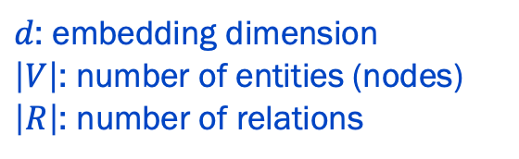
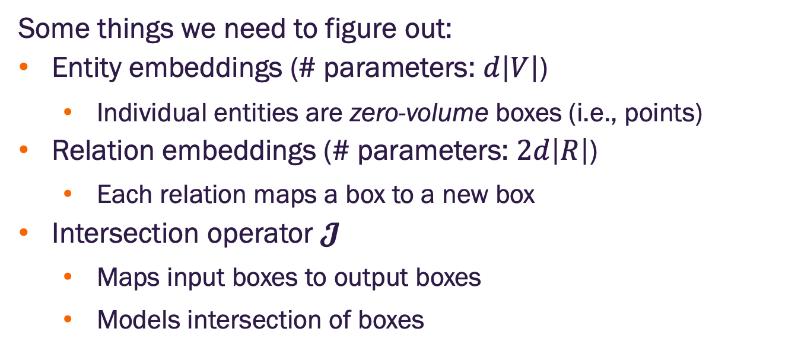
Box embeddings
Some things we need to figure out:
Entity embeddings (# parameters: $d\left|V\right|$)
Individual entities are zero-volume boxes (i.e., points)
Relation embeddings (# parameters: $2d\left|R\right|$)
Each relation maps a box to a new box
Intersection operator $𝓙$
Maps input boxes to output boxes
Models intersection of boxes
$d$: embedding dimension
$\left|V\right|$: number of entities (nodes)
$\left|R\right|$: number of relations

Slide 40
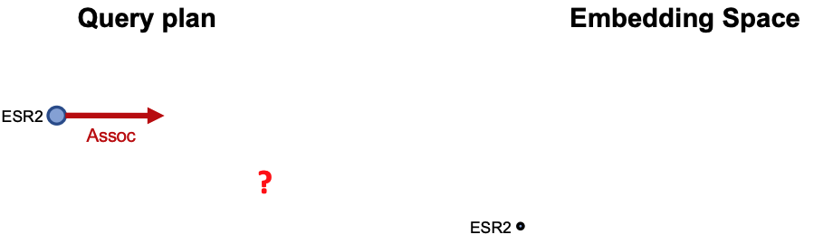
Embed conjunctive queries
Embed queries in vector space: What are drugs that cause shortness of breath and treat diseases associated with protein ESR2?
Query: [(e:ESR2, (r:Assoc, r:TreatedBy)), (e:Short of Breath, (r:CausedBy))]
Traverse KG from anchor nodes: ESR2 and Short of Breath
How should we do this?
Image credit: Jure Leskovec, http://cs224w.stanford.edu

Slide 41
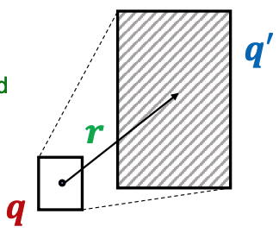
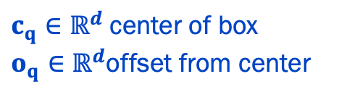
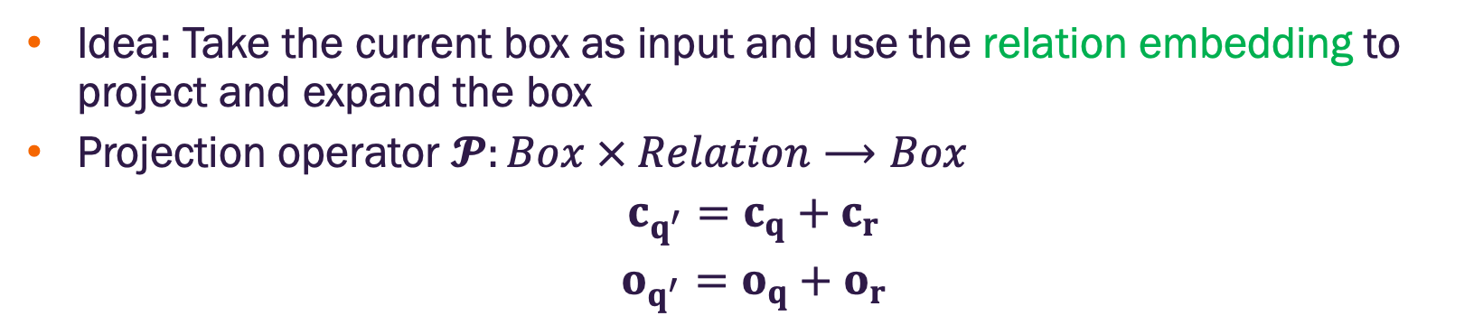
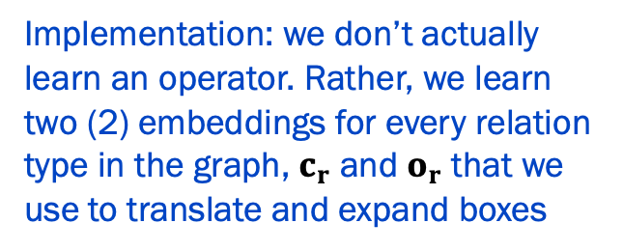
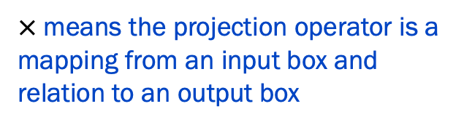
Projection operator
Idea: Take the current box as input and use the relation embedding to project and expand the box
Projection operator $𝓟:Box × Relation⟶Box$
$$c_{q^{′}}=c_{q}+c_{r}$$
$$o_{q^{′}}=o_{q}+o_{r}$$
$×$means the projection operator is a mapping from an input box and relation to an output box
$c_{q}∈ℝ^{d}$center of box
$o_{q}∈ℝ^{d}$offset from center
Implementation: we don’t actually learn an operator. Rather, we learn two (2) embeddings for every relation type in the graph, $c_{r}$ and $o_{r}$ that we use to translate and expand boxes
Image credit: Ren et al. 2020

Slide 42
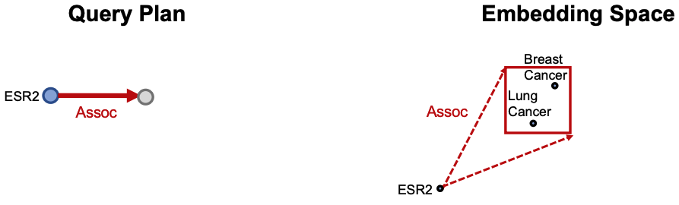
Embed conjunctive queries
Embed queries in vector space: What are drugs that cause shortness of breath and treat diseases associated with protein ESR2?
Traverse KG from anchor nodes: ESR2 and Short of Breath
Use the projection operator to follow the relations in the query plan
Image credit: Ren et al. 2020

Slide 43
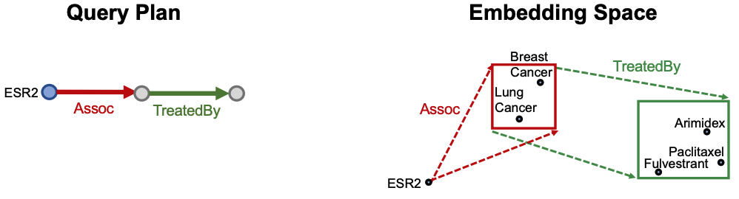
Embed conjunctive queries
Embed queries in vector space: What are drugs that cause shortness of breath and treat diseases associated with protein ESR2?
Traverse KG from anchor nodes: ESR2 and Short of Breath
Use the projection operator to follow the relations in the query plan
Image credit: Ren et al. 2020

Slide 44
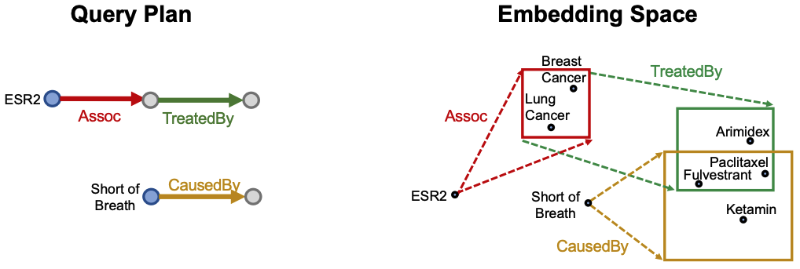
Embed conjunctive queries
Embed queries in vector space: What are drugs that cause shortness of breath and treat diseases associated with protein ESR2?
Traverse KG from anchor nodes: ESR2 and Short of Breath
Use the projection operator to follow the relations in the query plan
Image credit: Ren et al. 2020

Slide 45
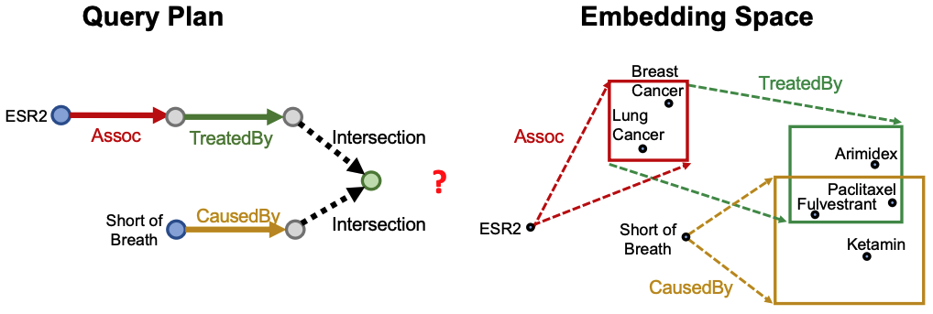
Embed conjunctive queries
Embed queries in vector space: What are drugs that cause shortness of breath and treat diseases associated with protein ESR2?
How do we take the intersection of the hyper-boxes?
The answer to the query is the set of elements in the intersection of the hyper-boxes
Image credit: Ren et al. 2020

Slide 46
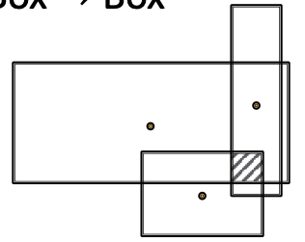
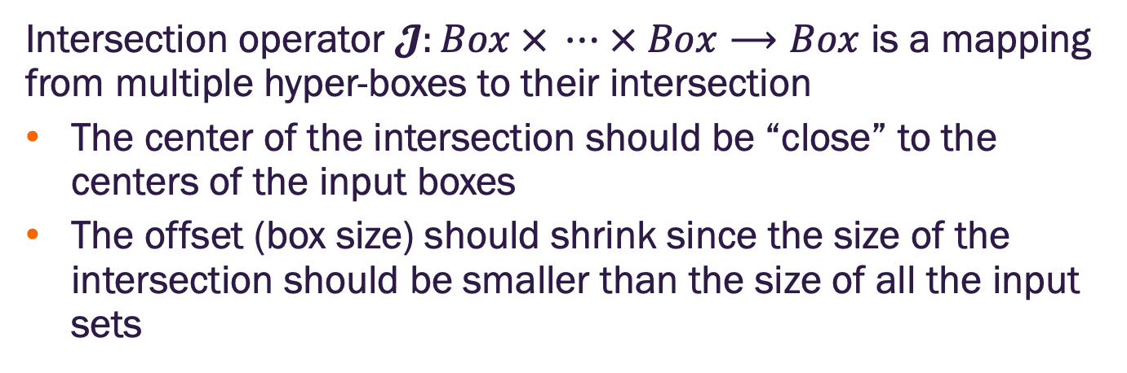
Intersection operator
Intersection operator $𝓙:Box × ⋯ × Box⟶Box$ is a mapping from multiple hyper-boxes to their intersection
The center of the intersection should be “close” to the centers of the input boxes
The offset (box size) should shrink since the size of the intersection should be smaller than the size of all the input sets
Image credit: Ren et al. 2020
Notes:
there's a straightforward geometric formula for axis-aligned hyperboxes in ℝ^d:
Box representation:
Box p₁: [Cen(p₁) - Off(p₁), Cen(p₁) + Off(p₁)]
Box p₂: [Cen(p₂) - Off(p₂), Cen(p₂) + Off(p₂)]
Issues with Raw Geometric Intersection:
Rigid/Brittle:
Forces strict geometric consistency
Empty intersection when boxes don't overlap
No gradient flow when intersection is empty
Not Learned from Data:
The formula is fixed, predetermined
Doesn't adapt to the specific structure of the KG

Slide 47
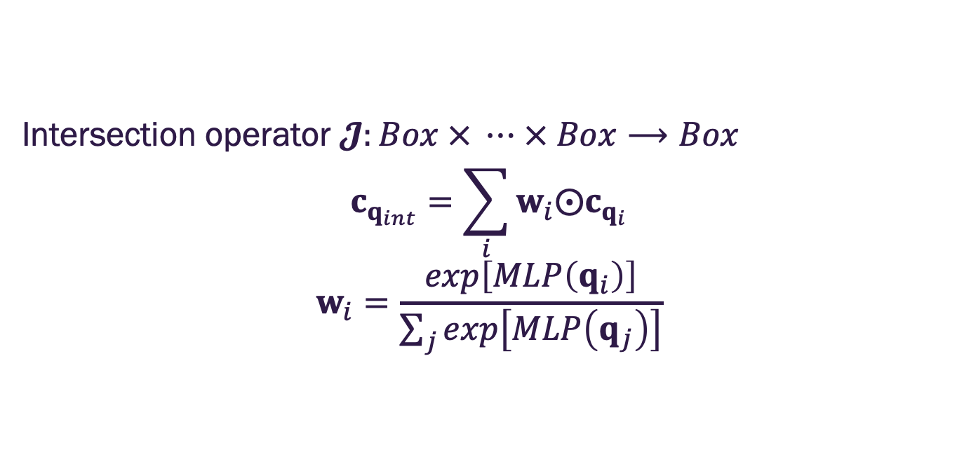


Intersection operator
Intersection operator $𝓙:Box × ⋯ × Box⟶Box$
$$c_{q_{int}}=\sum_{i}{w_{i}⨀c_{q_{i}}}$$
$$w_{i}=\frac{exp\left[MLP\left(q_{i}\right)\right]}{\sum_{j}{exp\left[MLP\left(q_{j}\right)\right]}}$$
$q∈ℝ^{2d}$is the box
$c_{q}∈ℝ^{d}$center of box
$o_{q}∈ℝ^{d}$offset from center
$⨀$ is the Hadamard product (element wise multiplication
MLP is a neural network with learnable parameters
The center of the intersection is a weighted sum of the input box centers and is in the red region
$w_{i}$ are attention scores over the individual input box centers
Image credit: Ren et al. 2020

Slide 48




Intersection operator
Intersection operator $𝓙:Box × ⋯ × Box⟶Box$
$$o_{q_{int}}=\min_{j}\left\{o_{q_{j}}\right\}⨀σ\left[f_{o}\left(\left\{q_{1},⋯,q_{j}\right\}\right)\right]$$
$σ$ sigmoid, guarantees shrinking of the box
$f_{o}$ is a neural network with learnable parameters that operates on sets (e.g., DeepSets)
The offset should be smaller than the offset of the input boxes but not necessarily equal to it
Design a neural network, $f_{o}$, to learn the appropriate scaling of the minimum input offset
Image credit: Ren et al. 2020

Slide 49

Embed conjunctive queries
Embed queries in vector space: What are drugs that cause shortness of breath and treat diseases associated with protein ESR2?
Combine the projection and box intersection operators
The shaded box represents the final box (with answers) for the query embedding
Image credit: Ren et al. 2020

Slide 50




Distance to the query box
Which entity embeddings are in the query box?
Consider a query box $q$ and an entity embedding $v$
Define the distance between $q$ and $v$ by
$${dist}_{box}\left(v;q\right)={dist}_{out}\left(v;q\right)+α∙{dist}_{in}\left(v;q\right)$$
where $0<α<1$ and
$${{dist}_{out}\left(v;q\right)=\left\|max\left(v−q_{max}, 0\right)+max\left(q_{min}−v, 0\right)\right\|}_{1}$$
$${{dist}_{in}\left(v;q\right)=\left\|c_{q}−min\left(q_{max},max\left(q_{min}, v\right)\right)\right\|}_{1}$$
where $q_{max}=c_{q}+o_{q}$ and $q_{min}=c_{q}−o_{q}$
element wise max / min
$${\left\|x\right\|}_{1}=\sum_{i}{\left|x_{i}\right|}$$
Setting $0<α$ downweights distance in the box, indicating entities are “close enough” to the query center
Image credit: Ren et al. 2020
Notes:
dist_outside corresponds to the distance between the entity and closest
corner/side of the box. Analogously, dist_inside corresponds to the distance between the center of the
box and its side/corner (or the entity itself if the entity is inside the box).
The key here is to downweight the distance inside the box by using 0 < α < 1. This means that
as long as entity vectors are inside the box, we regard them as “close enough” to the query center

Slide 51

Training Query2Box
What are the trainable parameters?
Entity embeddings (# parameters: $d\left|V\right|$)
Relation embeddings (# parameters: $2d\left|R\right|$)
Intersection operator$𝓙$ which contains two neural networks
Loss function
$$ℒ=−log\left[σ\left(γ−{dist}_{box}\left(v;q\right)\right)\right]−\frac{1}{k}\sum_{i=1}^{k}{log}\left[σ\left({dist}_{box}\left(v_{i}^{′};q\right)−γ\right)\right]$$
where $γ$ is a scalar margin, $v∈⟦q⟧$ is a positive entity (i.e., correct answer to the query, $q$) and $v_{i}^{′}∉⟦q⟧$ is the i-th negative entity (non-answer to $q$)

Slide 52
Training Query2Box
Training loop
Sample a query from training data, (q, v, v’)
Use current embeddings and intersection operator to embed q
Compute loss and update embedding and intersection operator weights
How do we obtain training data and implement training?

Slide 53

Generating sample queries on a KG
Start with query templates that represent possible query plans in the KG of interest
Different entity and relation types in the query templates as determined by the KG
Image credit: Jure Leskovec, http://cs224w.stanford.edu

Slide 54


Generating sample queries on a KG
Pick one of the query templates
Generate sample queries by instantiating every variable with a concrete entity and relation from the KG
Example: instantiate Anhcor 1 with ESR2, Rel1 with Assoc
How to do this systematically?
Image credit: Jure Leskovec, http://cs224w.stanford.edu

Slide 55

Generating sample queries on a KG
How to do this systematically?
Overview: Start by instantiating an answer node of the query template and iteratively instantiate the other edges and nodes until we ground all anchor nodes
Image credit: Jure Leskovec, http://cs224w.stanford.edu

Slide 56

Generating sample queries on a KG
How to do this systematically?
Start from the answer (root) of the query template. Why? As we will encounter intersections, we want to ensure the preceding paths include the final answer (see next slide)
Randomly pick one entity from the KG as the root node – in this example, Fulvestrant
Image credit: Jure Leskovec, http://cs224w.stanford.edu

Slide 57

Generating sample queries on a KG
How to do this systematically?
Since we are considering an intersection, we require that Fulvestrant is the entity ending the query paths at the preceding level in the query.
Image credit: Jure Leskovec, http://cs224w.stanford.edu

Slide 58

Generating sample queries on a KG
How to do this systematically?
Pick on of the branches (top). Instantiate the projection edge in the template by randomly sampling one relation associated with the current entity, Fulvestrant. For example, we might select TreatedBy and then check what entities are connected to Fulvestrant with TreatedBy: {Breast Cancer}
Image credit: Jure Leskovec, http://cs224w.stanford.edu

Slide 59

Generating sample queries on a KG
How to do this systematically?
Staying on the top branch, instantiate the next projection edge by randomly sampling one relation associated with Breast Cancer. For example, we might select Assoc and then check what entities are connected to Breast Cancer with Assoc: {ESR2}
Image credit: Jure Leskovec, http://cs224w.stanford.edu

Slide 60

Generating sample queries on a KG
How to do this systematically?
Now we move to the next (bottom) branch. We instantiate the projection edge by randomly sampling one relation associated with Fulvestrant. For example, we might select CausedBy and then check what entities are connected to Fulvestrant with CausedBy: {Short of Breath}
Image credit: Jure Leskovec, http://cs224w.stanford.edu

Slide 61

Generating sample queries on a KG
How to do this systematically?
Finally, we select the last entity from {Short of Breath}
Image credit: Jure Leskovec, http://cs224w.stanford.edu

Slide 62
Generating sample queries on a KG
We now have a fully instantiated query
[(e:ESR2, (r:Assoc, r:TreatedBy)), (e:Short of Breath, (r:CausedBy))]
We can obtain the “known” answers by traversing the KG – this will NOT account for incompleteness
We can then randomly select negative answers that are not in the known answers (there is the chance of false negatives)
Image credit: Jure Leskovec, http://cs224w.stanford.edu

Slide 63


